Slide 1
Portfolio Optimization & ML PREDICTIVE MODELS with focus on Trade Signals GENERATION using Moving Average (MA) Crossover Strategy (A Python implementation)
Abdoulaye Kane, FINTECH CP
Olagoke Michael Kupolati, FINTECH CP

Slide 2
AGENDA
Introduction
Primary goals
Project Description/Methodology
Implementation/Results
Looking forward

Slide 3



INTRODUCTION
Moving averages are commonly used in technical analysis of stocks to predict the future price trends. In this project, we have developed a Python script to generate buy/sell signals using simple moving average (SMA) and exponential moving average (EMA or EWMA) as well as evaluate train test split model validation procedure to reveal how the model performs on new data
Indicators such as Moving averages (MAs), Bollinger bands, Relative Strength Index (RSI) are mathematical technical analysis tools that traders and investors use to analyze the past and anticipate future price trends and patterns. Where fundamental analysts may track economic data, annual reports, or various other measures, quantitative traders and analysts rely on the charts and indicators to help interpret price moves.
The goal when using indicators is to identify trading opportunities and invest in a maximizing way with a view to optimizing the value of the portfolio.

Slide 4
PRIMARY GOALS
Building a powerful tool to perform technical analysis and generate trade signals using moving average crossover strategy.
Portfolio Prediction- stocks, crypto & futures
Performing back testing to evaluate the performance of different strategies using appropriate metrics

Slide 5
Dataframe & SIGNALS - INDEX_SP100.csv

Slide 6
Dataframe & SIGNALS - INDEX_NASDAQ.csv

Slide 7
Dataframe & SIGNALS - INDEX_TSX.csv

Slide 8
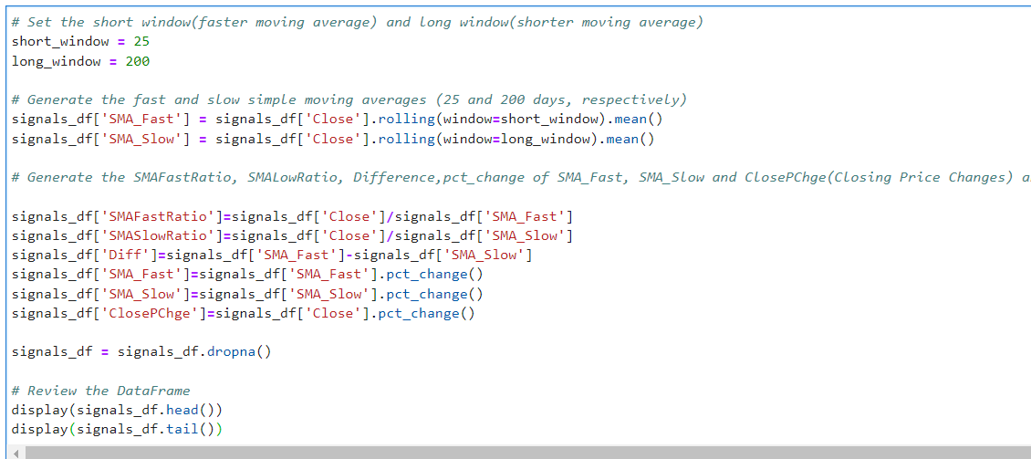
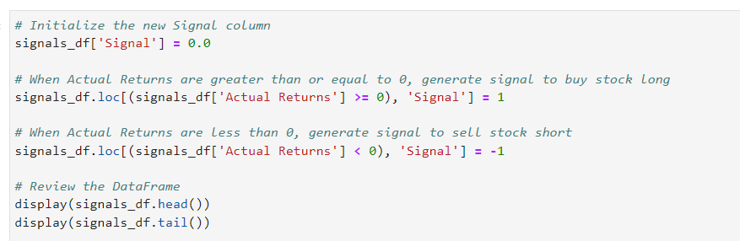
CODE snippets
​ | CATEGORY 1 | CATEGORY 2 | CATEGORY 3​ | CATEGORY 4​
Q1 | 4.5​ | 2.3​ | 1.7​ | 5​.0
Q2 | 3.2​ | 5.1​ | 4.4​ | 3​.0
Q3 | 2.1​ | 1.7​ | 2.5​ | 2.8​
Q4 | 4.5​ | 2.2​ | 1.7​ | 7.0

Slide 9
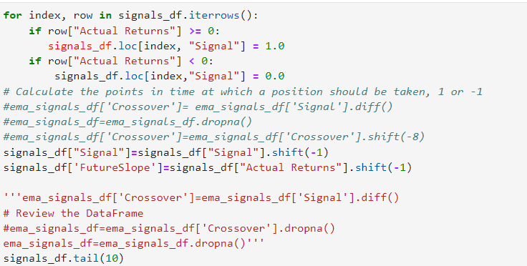
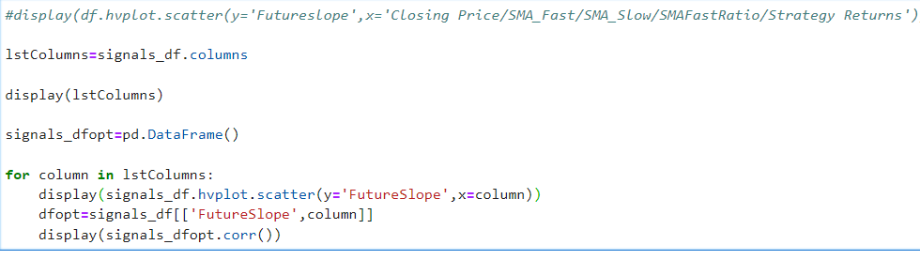
CODE SNIPPETS

Slide 10
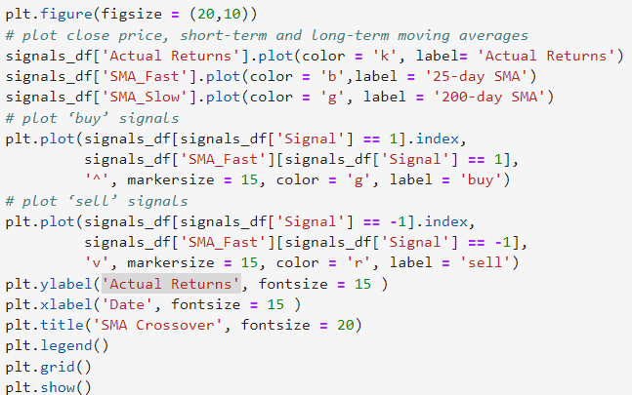
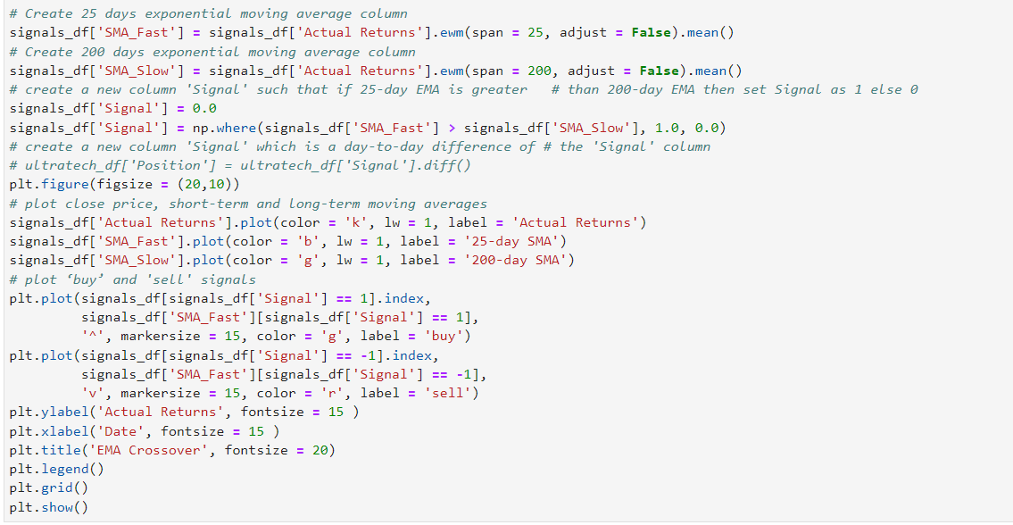
CODE SNIPPETS
​ | CATEGORY 1 | CATEGORY 2 | CATEGORY 3​ | CATEGORY 4​
Q1 | 4.5​ | 2.3​ | 1.7​ | 5​.0
Q2 | 3.2​ | 5.1​ | 4.4​ | 3​.0
Q3 | 2.1​ | 1.7​ | 2.5​ | 2.8​
Q4 | 4.5​ | 2.2​ | 1.7​ | 7.0

Slide 11
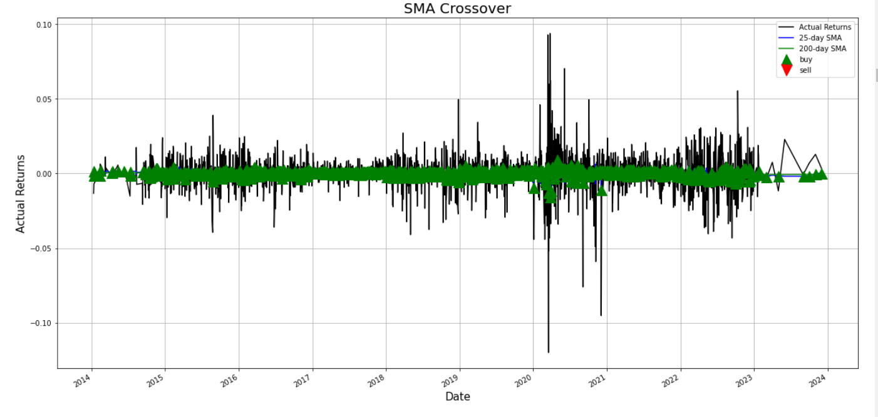
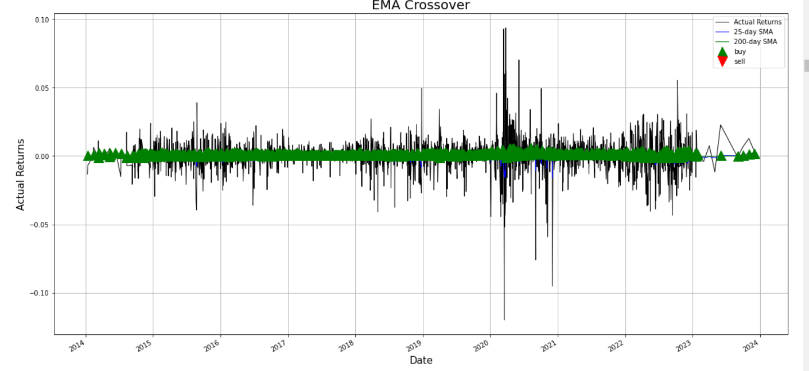
SMA/EMA CROSSOVER –INDEX_SP100

Slide 12
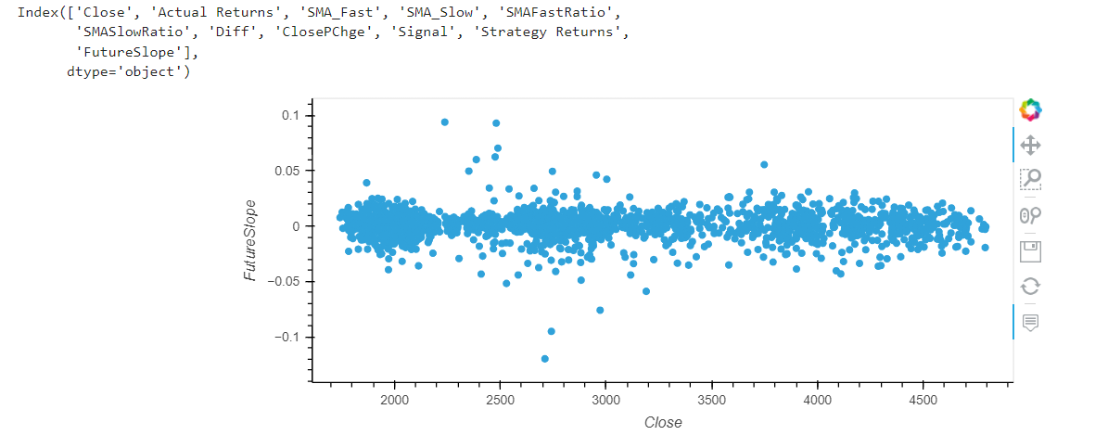
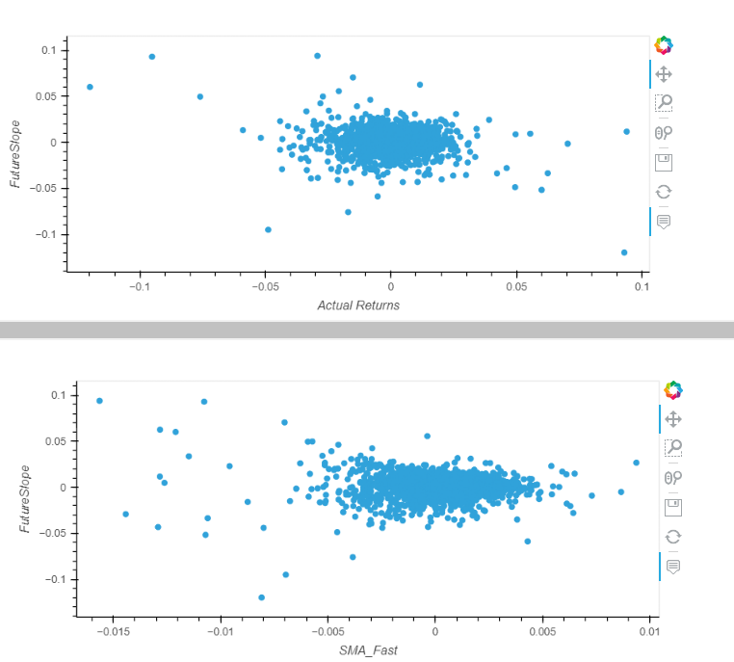
hvplot.scatter - INDEX_SP100

Slide 13


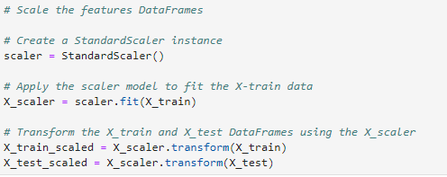
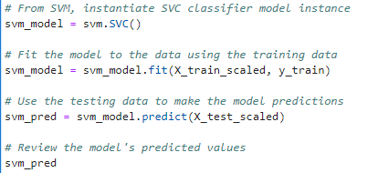
Model Validation Procedure Train test split

Slide 14
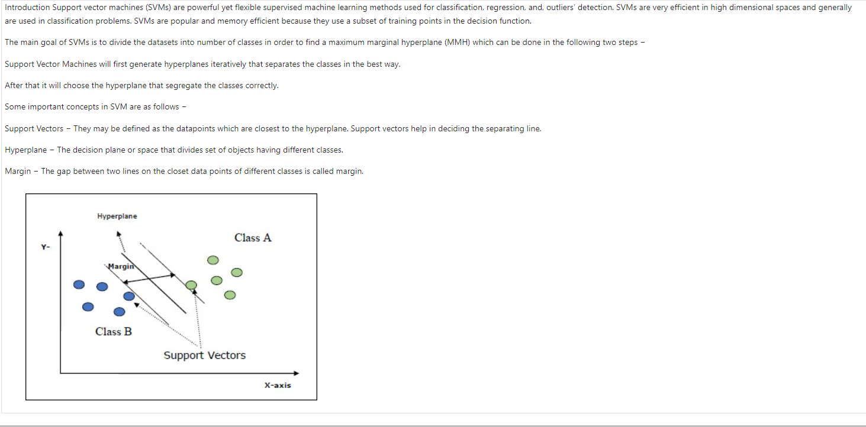
Support vector machines (SVMs)

Slide 15
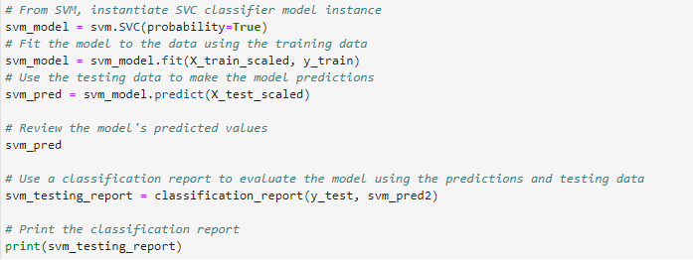
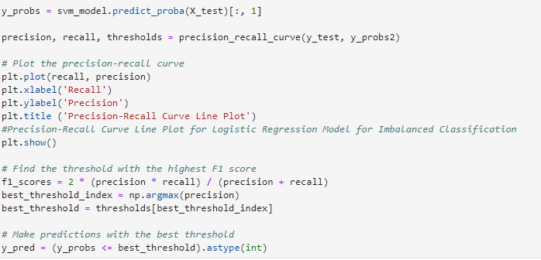
Review the classification report associated with the SVC model predictions

Slide 16
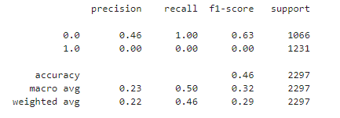
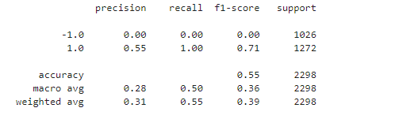
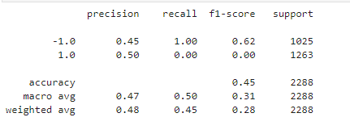
svm_testing_report
INDEX_SP100
INDEX_NASDAQ
INDEX_TSX

Slide 17
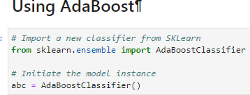
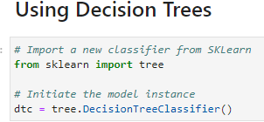
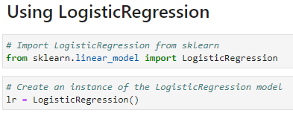
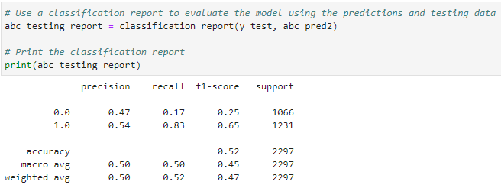
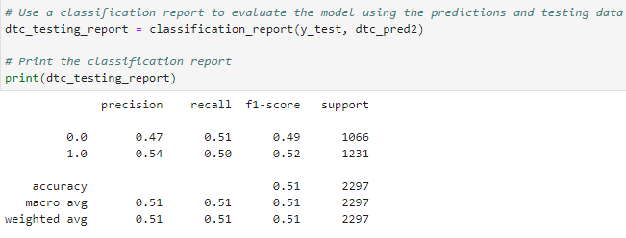
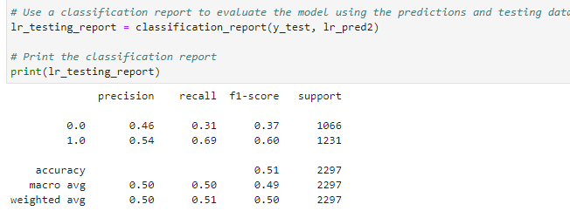
Evaluate a New Machine Learning Classifiers
INDEX_SP100
INDEX_NASDAQ
INDEX_TSX

Slide 18
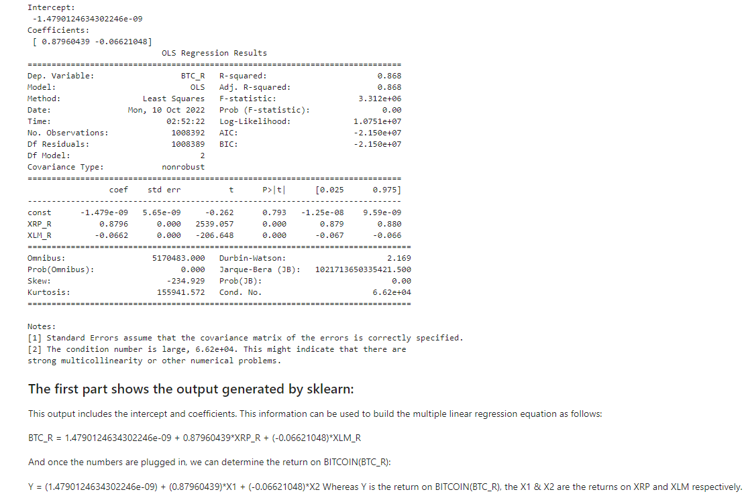
Performing the Multiple Linear Regression of crypto currencies for optimization
Performing the Multiple Linear Regression

Slide 19
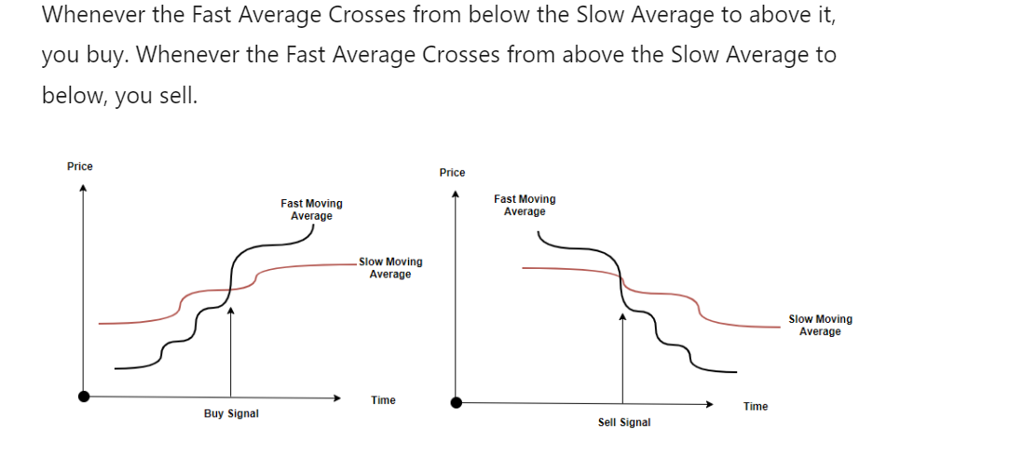
findings
r2 = r2_score(y_test, mymodel(X_test)). The result, R-squared, r2= 0.809 shows that the model fits the testing set as well, and we are confident that we can use the model to predict future values.
Best_threshold at 0.757772942247354 i.e threshold that results in the best balance of precision and recall(same as optimizing the F-measure that summarizes the harmonic mean of both measures)
We carried out a portfolio analysis of the combine index_sp100, index_nasdaq, and index_tsx. The outcomes are also revealing.

Slide 20
CONCLUSION
I hope this worksheet has provided a framework to test more (and hopefully better) ideas utilizing ML Models.
FUTURE WORK
Can test over different granularities such as seconds, hours, days & months or see how it does with intraday trading.
Make a more robust model that possibly forecast movement vs. trying to capture a very noise next day indicator.
Try to predict a target further in the future than a day.
Find a better Slow/Fast Window optimization method that could consider a region of values vs. just the max value.
Run this strategy over a portfolio to have less dead time for our money.

Slide 21


MEET OUR TEAM
Olagoke Michael Kupolati
Abdoulaye Kane
Chief Executive Officer
President

Slide 22
THANK YOU
Olagoke Michael Kupolati
gkupolati@gmail.com
https://github.com/gkupolati/Final_Project_AlgorithmicTrading_SmartContract.git

